Slide 1


Ledger Management System for Sivasakthi Stores
24PR01
Immanuvel R
Krittika R
Barath Kumar R

Slide 2
Company Details
Company Name : Sivasakthi Stores
Location : 1/376-A, Theertham road, Veppanapalli, Krishnagiri, 635121
Contact : +91 9080660749
Core Business : Retail store specializing in Diwali festival goods and chit management
Established
Customer Base : Local community in Veppanapalli region
Email : madhuguna1982@gmail.com

Slide 3
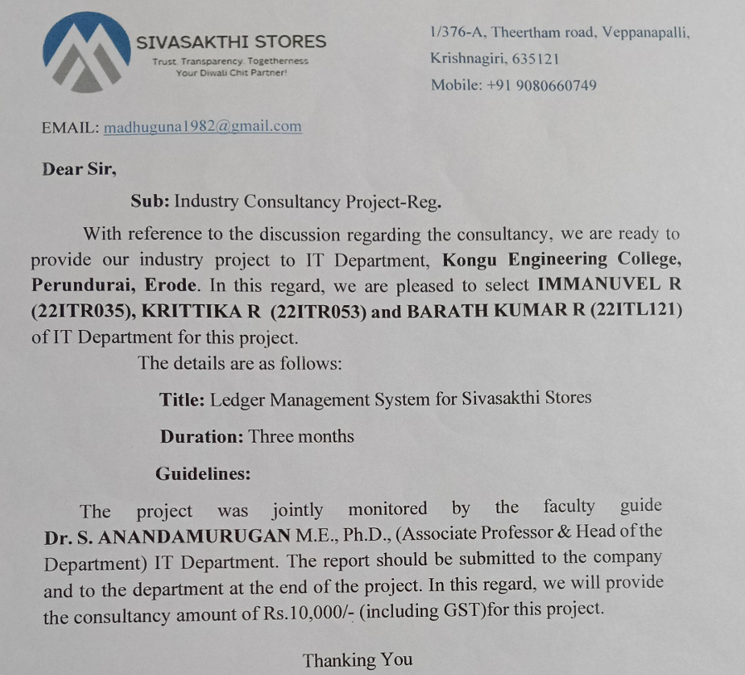
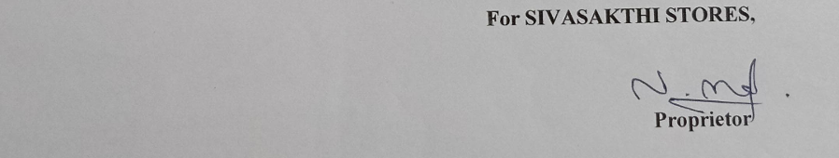
Approval
Letter

Slide 4
Problem Identified
Sivasakthi Stores, a local retail establishment in Veppanapalli, Krishnagiri, has been managing its Diwali chit fund through traditional paper-based methods. This approach has led to several challenges:
1. Inefficient Record Keeping
2. Limited Accessibility
3. Scalability Issues
4. Lack of Real-time Updates
5. Data Security Concerns
6. Reporting Challenges
7. Payment Tracking Difficulties

Slide 5
—Madhu Kumar
“Sometimes I feel like instead of managing the details of 600 people for the whole year, I would simply stop this service ”

Slide 6
Requirements Gathered
Customer profile management
Search and filter capabilities
Database integration
Multiple chit categories
(Gold: ₹500/month, Silver:₹300/month)
Detailed product inventory management
Secure user authentication and admin panel
Payment tracking and history

Slide 7

A picture is worth a thousand words

Slide 8
LedgerGlow

Slide 9

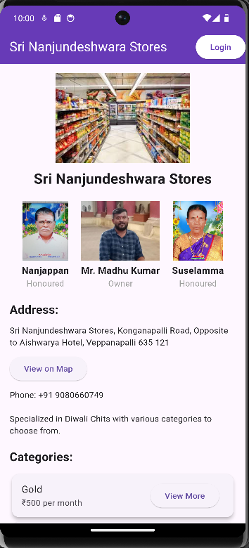

Solution
So based on the problem, we have come up with an App which helps in Chits management

Slide 10



Methodologies
Frontend
Backend
Database
Flutter/Dart
Node.js with Express
MongoDB

Slide 11
Objective
01
02
03
04
05
06
Digitize traditional chit fund management system
Implement secure user authentication system
Streamline customer registration and payment tracking
Provide real-time payment history access
Facilitate easy administration of multiple chit categories
Implement notification system for important updates

Slide 12
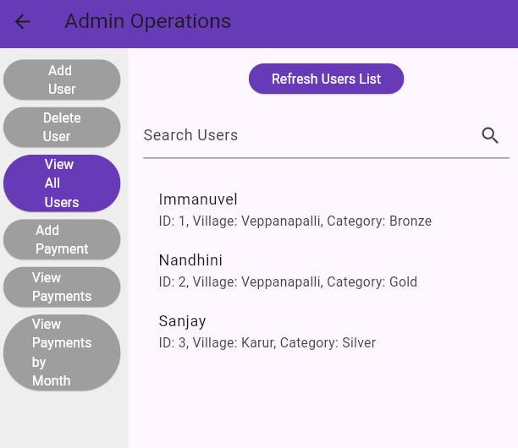
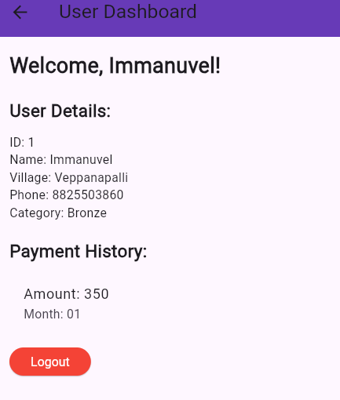
Implementations
02
Implement secure user authentication system
01
Digitize traditional chit fund management system
03
Streamline customer registration and payment tracking
04
Provide real-time payment history access
05
Facilitate easy administration of multiple chit categories
06
Implement notification system for important updates

Slide 13
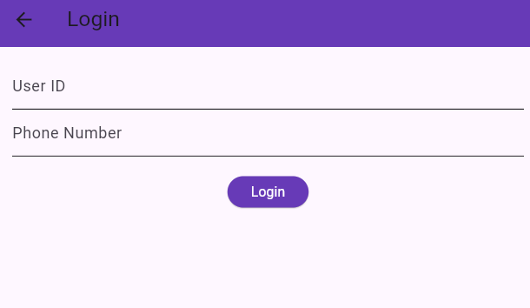
Implementations
02
Implement secure user authentication system
03
Streamline customer registration and payment tracking
04
Provide real-time payment history access
05
Facilitate easy administration of multiple chit categories
06
Implement notification system for important updates

Slide 14
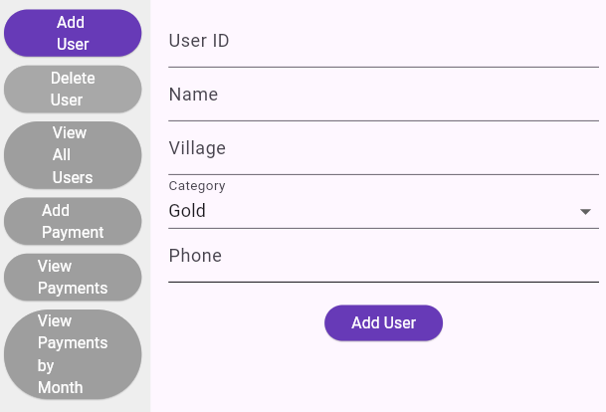
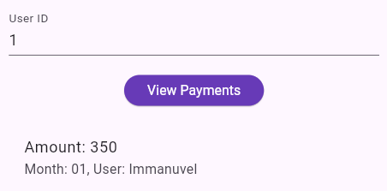
Implementations
03
Streamline customer registration and payment tracking
04
Provide real-time payment history access
05
Facilitate easy administration of multiple chit categories
06
Implement notification system for important updates

Slide 15
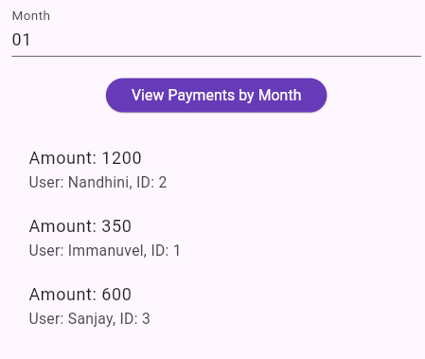
Implementations
04
Provide real-time payment history access
05
Facilitate easy administration of multiple chit categories
06
Implement notification system for important updates

Slide 16
Yet To Be Completed
05
Facilitate easy administration of multiple chit categories
06
Implement notification system for important updates

Slide 17




Our principal team
JENNA WILLSON
TIMMY JIMMY
SUSAN BONES
PETER SMITH
You can speak a bit about this person here
You can speak a bit about this person here
You can speak a bit about this person here
You can speak a bit about this person here

Slide 18

2000 Customers
The target of Mr. Madhu Kumar by 2026

Slide 19
Gold Platings!!
01
02
Provide a map to the store
Real-time notifications
Featuring the shop owner’s father and mother in home page
03

Slide 20

Thank You!

Slide 21
Economy icon pack

